Slide 1
ECE 352 Digital System Fundamentals
Implementation Technologies
Notes:
In this presentation, we will discuss different ways that we can implement combinational logic.

Slide 2
Implementation Technologies
“Custom” hardware
Full Custom
Must manually “draw” diffusion, polysilicon, metal, etc.
Drawings are used as masks to fabricate multi-layer chips
Standard Cell
Use a tool suite to translate gate-level design to automatic transistor-level layout
“Programmable” hardware (FPGAs)
Resources customizable post-fabrication
This is not loading a software program!
It actually implements a logic circuit!
Usually controlled by small memory bits
We use this type of hardware in this course
Notes:
There are two main categories of implementation technologies people use for digital logic circuits: custom hardware, and programmable hardware. Custom hardware requires a factory to create the integrated circuit, also called an “IC”.
One type of custom hardware involves creating a full-custom design all the way down to the size, position and interconnection of transistors on the silicon wafer. Another type is to use what is called a standard cell design method, which uses automated tools to translate circuits into structures built from small pre-designed building blocks. This approach still requires a factory, but less designer effort.
Programmable hardware, on the other hand, is hardware that can be configured to implement different circuits after it is manufactured. There are a number of programmable technologies available, but the dominant one is the field-programmable gate array, or FPGA. Here, “programmable” does not refer to software; programming an FPGA means configuring it to implement a hardware circuit by setting the values of millions of memory bits in the device. You’ll be using FPGAs in this course to implement logic circuits.

Slide 3
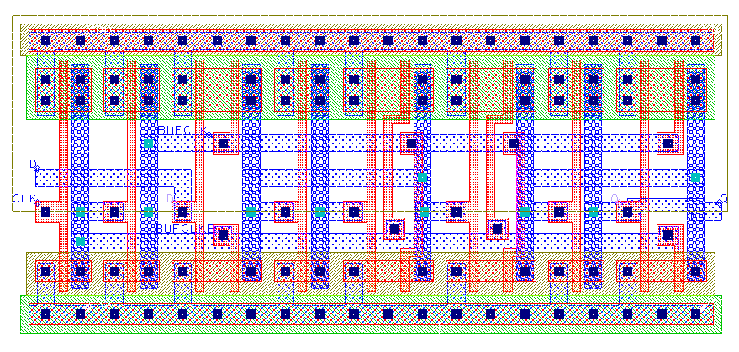
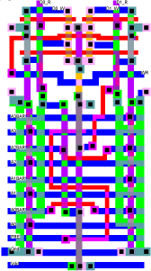
Custom Hardware Examples
Full Custom
Manual layout makes efficient circuits…
Huge design time!
Expensive!
Standard Cells
Predefined layouts for gates / small structures
Automatic tools place cells and connect them
Not quite as efficient…
Each of these cells is a logic gate
A small standard-cell logic circuit
Notes:
Let’s first compare the two types of custom hardware.
Full custom designs require designing each transistor and interconnection. They are incredibly difficult and time-consuming to design, and it takes even longer to verify that they work correctly. This makes them very expensive and they have a long time-to-market. However, they have the advantage that they are optimized exactly for a single purpose, and so are very power- and performance-efficient.
By using a library of standard cells, we eliminate much of the very low-level design work. Automated tools convert a gate-level circuit by replacing the gates with pre-designed cells, then connecting them as needed. Here are a couple examples of standard cells – the one on the left is actually a NOT gate. Notice each cell is designed to be the same height, so they can be placed next to one another in rows on the silicon. Power and other signals can be routed between the rows. Note that standard cell design is still custom hardware – you can’t change the circuit after it is manufactured. Using these building blocks simplifies the problem to the point where automated tools can arrange and connect the cells instead of doing it manually. The tradeoff is that we can’t make the circuit quite as small or fast.

Slide 4
Programmable Hardware
Types of devices:
FPGAs (Field-Programmable Gate Arrays) are the dominant technology
Other devices are still used: ROMs, PLDs (PAL/PLA)
There are tradeoffs…
Programmability takes up area, adds delay, consumes more power/energy compared to custom hardware
Programmable Logic Technologies:
Permanent (program once)
Examples: Fuse, Antifuse
Reprogrammable (memory-based)
Examples: SRAM, Flash, EEPROM, EPROM
Notes:
Let’s get back to the other category of hardware: programmable hardware. There are many types of programmable hardware, but in this course we will focus on FPGAs.
Whenever we use a programmable logic device, we have to accept trade-offs in terms of area, power, and speed. Basically, the extra transistors required to make the hardware customizable after fabrication add overhead. So why use them? When you create a custom circuit, getting the first one built on silicon will cost millions of dollars in development costs. So, you’ll need to sell a LOT of that circuit to amortize those costs. That’s what the FPGA manufacturers are doing – FPGAs are very expensive to develop, but they sell a lot of them. So, when you buy an FPGA, you only pay a small share of its development cost.
There are various technologies used to configure programmable logic, both in FPGAs and other devices. Some can only be programmed once by making or breaking connections, while others are based on small memories that store the configuration data, and we change the circuit they implement by loading new values into those memories. This is the type we will use in this class so that we can use the same FPGA over and over again to implement different circuits.

Slide 5
FPGAs
Logic: configure Look-Up Tables (LUTs) with function truth tables
Memory bits hold mux data input values (function’s truth table)
Mux selects are input variables of function
Routing: configure to connect LUTs
Configurable wire connections
Configurable routing multiplexers
memory bits
inputs
output
Notes:
There are fundamentally two things that get configured in an FPGA.
Logic functions are implemented in LUTs, which are small memories. We load the memory with the truth table for the function we need to implement. The function variables are used to select which memory location produces the output. So if the three inputs are all zeros, then the value stored in bit P0 will appear at the output of the LUT.
The configuration data also specifies the internal connections within the FPGA. This turns on or off transistors that make connections between wires in the chip. This “pass gate” is conceptually similar to a tristate buffer, which also might be used. There also may be multiplexers with configurable selects to choose the input signals for structures like LUTs.

Slide 6
FPGAs
One or more LUTs are grouped to form “logic blocks” (also called CLBs or “logic elements”)
A massive number of logic blocks are arranged in a grid of wires
Like buildings and roads in a city…
Logic blocks and the connections between them are programmable
= KL$\overline{\text{N}}$
= KL$\overline{\text{N}}$ + MG
G
M
K
L
N
Notes:
A typical FPGA is made up of tens or hundreds of thousands of “logic blocks” that contain one or more LUTs and small amounts of storage. These logic blocks are connected by configurable wiring like we showed previously.
The blocks and wires are organized like a rectangular grid of city blocks and streets. Here we show a block diagram, where the boxes labeled CLB are the logic blocks. The little circles represent places where a connection can be made between crossing wires, using structures like the pass gate we discussed. In this case, each CLB has four inputs, which come from the wire channel below it. Each CLB produces one output, which can be connected to any of the wires in the channel to the CLB’s right. We can also make connections between horizontal and vertical wires to route signals wherever we need.
So, we might implement part of a logic function in one CLB, and connect its output to the input of another CLB that implements another part of the function.
Don’t try to memorize the particular features of this image; it’s just a generic picture to give you an approximate idea. Real FPGAs have many more CLBs, wires, and connection points. This is how we can implement very large and complex designs on a single FPGA using these small building blocks.

Slide 7
Implementing on FPGAs
Circuit is transformed by design tools to break it into smaller functions with connections between
These are automatically mapped to the logic blocks and wires in the FPGA chip
Tool generates a bitstream (sequence of binary values) that implements the transformed circuit
We “program” the FPGA by loading the bitstream
Does NOT mean we write a program to simulate the hardware we want
The FPGA is NOT running a program
Instead, this hardware is designed specifically to let us customize what it does by loading truth tables and making connections!
Notes:
So, how do we configure an FPGA to implement our circuit? We can implement any logic function of N variables using an N-to-1 mux and value-fixing. This is essentially what happens inside the FPGA. The configuration data, stored in memories, value-fixes the data inputs of a lot of small muxes. The this data also controls which signals within the FPGA are applied to the select inputs of the muxes.
Automated design tools take the circuit you design, and transform it to use the structures available in the FPGA, while preserving the functionality. They break up the logic into smaller functions that can be implemented in the logic blocks, then figure out which logic block to use for each subfunction. Then, they determine how to use the routing resources in the FPGA to connect those subfunctions to form the complete circuit. The design tools then generate a sequence of binary configuration data called a bitstream, and when we load that bitstream into the FPGA, the FPGA becomes the circuit that we designed.
Remember, when we say that we “program” the FPGA, it does not mean that we write a software program. The FPGA is not a microprocessor that executes instructions, and this is not software. When we program the device, we are actually customizing the hardware.

Slide 8
Look-Up Table (LUT)
Has one output, multiple inputs
Defined by manufacturer – you’ll be told how many
Can implement any function of its inputs
…because it can store the truth table!
If a function has more inputs than the LUT size, it must be implemented using multiple LUTs
Decompose the function and use substitution to break up the function
FPGA design tools will do this for you, but you should know how to do it!
Notes:
Let’s look in more detail at how LUTs can be used to implement logic functions. A LUT has multiple inputs and one output. The exact number of inputs varies between FPGA models. Since a LUT with N inputs stores the truth table of the function, it can implement ANY function of N variables. If a function has more variables than the number of LUT inputs, the function must be decomposed into smaller sub-functions that can be implemented in the available LUTs. This is done automatically by the FPGA tools, but you should know how to do it manually as well.

Slide 9
Implementing With LUTs
Implement the below circuit using 3-input LUTs
Remember: max 3 inputs, 1 output, any function!
Let $\text{G}\text{ = }\text{AB}\text{ + }\overline{\text{B}}\text{C}$
G
Now F$\text{ = }\text{G}\text{ + }\text{D} \text{E}\text{ + }\overline{\text{D}} \overline{\text{E}}$
Notes:
Let’s assume we want to implement this circuit using 3-input LUTs, commonly called 3-LUTs. A 3-LUT can implement any function of 3 variables, but our circuit has five inputs, so we need to divide up the circuit into multiple LUTs. Let’s choose to take the circled logic and replace it with a sub-function G which equals AB + /BC. We can then substitute G back into the original function, as shown.

Slide 10
Implementing With LUTs
Implement the below circuit using 3-input LUTs
Remember: max 3 inputs, 1 output, any function!
Let $\text{G}\text{ = }\text{AB}\text{ + }\overline{\text{B}}\text{C}$
Now F$\text{ = }\text{G}\text{ + }\text{D} \text{E}\text{ + }\overline{\text{D}} \overline{\text{E}}$
LUT
G
F is now a function of three variables (G, D, and E)
Notes:
We implement the G sub-function using a single 3-LUT, which replaces the circled logic. F is now a function of 3 variables (G, D, and E), so we can implement the remaining logic using another 3-LUT.

Slide 11
Implementing With LUTs
Implement the below circuit using 3-input LUTs
Remember: max 3 inputs, 1 output, any function!
Let $\text{G}\text{ = }\text{AB}\text{ + }\overline{\text{B}}\text{C}$
Now F$\text{ = }\text{G}\text{ + }\text{D} \text{E}\text{ + }\overline{\text{D}} \overline{\text{E}}$
LUT
G
LUT
F is now a function of three variables (G, D, and E)
Notes:
Here is the final circuit. With the 3-LUTs configured with the indicated logic functions, the resulting circuit has the same behavior as the original gate diagram. Of course, to know what a LUT-based circuit does, we need to know what function is implemented by each LUT.

Slide 12
ECE 352 Digital System Fundamentals
Implementation Technologies
Notes:
Hopefully, you now have a better idea of how we actually implement digital logic circuits. This concludes our video.

