Slide 1
ECE 352 Digital System Fundamentals
Other Flip-Flop Types
Notes:
Although the D flip-flop is the dominant type is use today, there are other types of flip-flops you are likely to encounter.

Slide 2
Other Latch and FF Types
You do not need to memorize how these other latch/flip-flop types work for this class
You should know that they exist (sometimes companies ask about them during job interviews)
The behavior of a flip-flop is described using a “characteristic table”
The table indicates how it responds to the input(s)
Given a characteristic table for a flip-flop, you do need to understand how it works and be able to use it to implement an FSM
Even if you have never seen that FF type before!
Notes:
We will be looking at a number of different types of storage elements, but you do not need to memorize the details of how each one operates. Instead, you’ll be given the description of how the latch or flip-flop behaves in the form of a “characteristic table”. This type of table lists how a device responds to its inputs. You DO need to know how to use the information in a characteristic table to determine how a latch or flip-flop behaves. You also need to be able to use that information to design an FSM with a certain type of flip-flop, even if you have never seen that type before.

Slide 3
SR Latch (NOR)
S refers to “set”, R refers to “reset”
NOR SR Latch Characteristic Table
Inputs |  | Next State Q(t+1) | Operation
S | R
0 | 0 | Q(t) | Hold (no change)
0 | 1 | 0 | Reset
1 | 0 | 1 | Set
1 | 1 | ??? | Undefined
Notes:
First, let’s look at the SR latch. The SR latch is a level-sensitive storage device consisting of a pair of cross-coupled NOR gates. The latch has two outputs, Q and /Q, that, during correct operation, are opposite in value. The S input refers to “set”, and the R input refers to “reset”, two terms you are already familiar with. The characteristic table lists all possible combinations of S and R, and what the next state will be given the current state. If both S and R are 0, the latch will hold whatever value it is currently storing. If R is 1 and S is 0, then the latch will be reset to 0. If R is 0 and S is 1, then the latch will be set to 1. If both R and S are 1, the latch dos not behave in a useful way, as we will see.

Slide 4
SR Latch Timing Waveform
The Q and $\overline{\text{Q}}$ outputs are both unknown until S and R are known
When S = R = 1, Q = $\overline{\text{Q}}$ = 0!
If we try to “hold” afterwards with S = R = 0, the value in the latch oscillates…
Notes:
Here we use a timing waveform to demonstrate the behavior of the SR latch. Note that the stored value is not known until the latch has either been set or reset. Also note that when S=R=1, the outputs of both NOR gates are forced to 0, so both Q and /Q are 0—clearly an undesirable state because it does not make any sense with the naming of the outputs. If we then simultaneously set R and S to 0, the latch goes into oscillations that will continue until either S or R becomes 1 and changes the state of the latch to a valid state. For this reason, designs using the SR latch should ensure that S and R can NEVER be 1 simultaneously.

Slide 5

$\overline{\text{S}} \overline{\text{R}}$ Latch (NAND)
Can make an $\overline{\text{S}} \overline{\text{R}}$ latch with NANDs
Inputs become active-low
NAND $\overline{\text{S}} \overline{\text{R}}$ Latch Characteristic Table
Inputs |  | Next State Q(t+1) | Operation
$$\overline{\text{S}}$$ | $$\overline{\text{R}}$$
0 | 0 | ??? | Undefined
0 | 1 | 1 | Set
1 | 0 | 0 | Reset
1 | 1 | Q(t) | Hold (no change)
Notes:
We can also construct a latch using cross-coupled NAND gates, the /S/R latch. The behavior is equivalent to the SR latch, except the inputs are now active-low.

Slide 6
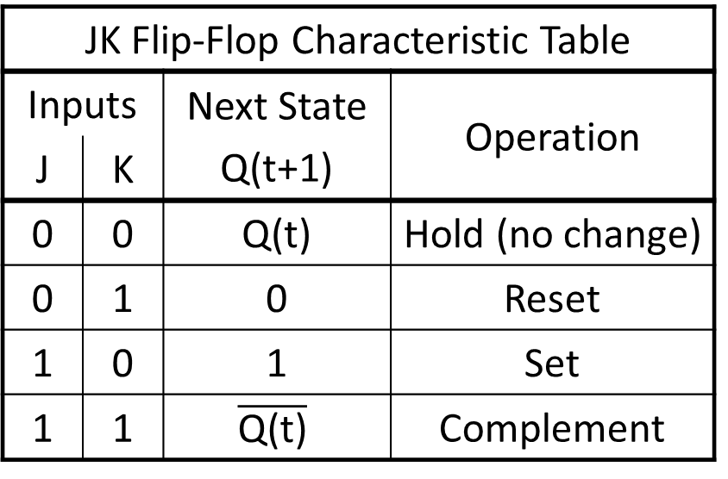
JK Flip-Flop
Based on SR latches
J → S, K → R
Avoids the undefined case!
JK Flip-Flop Characteristic Table
Inputs |  | Next State Q(t+1) | Operation
J | K
0 | 0 | Q(t) | Hold (no change)
0 | 1 | 0 | Reset
1 | 0 | 1 | Set
1 | 1 | $$\overline{\text{Q}\text{(}\text{t}\text{)}}$$ | Complement
Notes:
Historically, the JK flip-flop was based on SR latches, but was designed to eliminate the undefined case. The J input corresponds to the S input, and the K input corresponds to the R input. Note that the JK flip-flop has a clock input. It is an edge-sensitive device, so state changes only occur at the active clock edges. In other words, it’s a flip-flop, not a latch. If the J and K inputs are both 1, at each clock edge the new Q value will be the complement of the previous Q value, which we refer to as “toggling”.

Slide 7
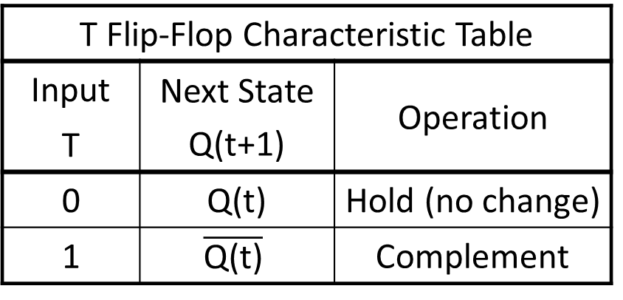
T Flip-Flop
“Toggle” FF is equivalent to JK FF with J=K=T
MUST have a set or reset input to start at a known initial value
T Flip-Flop Characteristic Table
Input | Next State Q(t+1) | Operation
T
0 | Q(t) | Hold (no change)
1 | $$\overline{\text{Q}\text{(}\text{t}\text{)}}$$ | Complement
Notes:
There is another type of flip-flop that can toggle – the toggle flip-flop. It has a single input, T. When T is 0, the flip-flop holds its current state. When T is 1, the state is complemented at each clock edge; hence the input is named T for toggle. The toggle flip-flop must have a set or reset input to get it into a known initial state, since the T input only controls whether it holds or toggles the value already stored in the flip-flop.

Slide 8
Using Other Flip-Flop Types
Create state table as usual
But “Next State” no longer equal to the FF input…
That was only the case because a D flip-flop’s next state is equal to its D input!
Add extra column(s) for the flip-flop input(s)
For each row of the state table, determine which FF input value(s) will cause the flip-flop to enter the required next state
Refer to the flip-flop’s characteristic table
Create the combinational logic for the FF inputs and the circuit output
Notes:
So, how do we use these other flip-flop types to create an FSM? We start by creating the usual state table, with one difference. With the D flip-flop, we just used the “Next State” column to determine the D input of the flip-flop, because the next state of a D flip-flop is in fact the value on the D input. However, that is not the case for other flip-flop types, so we need to add columns to the state table for the flip-flop inputs. Then, we look at each row of the state table, and figure out, according to the characteristic table for that flip-flop type, what flip-flop input values are required to cause the flip-flop to store the required next state value. Once we’ve filled in the columns for each flip-flop input, we use those value to create the required combinational logic. Now let’s look at few examples that should help make this process more clear.

Slide 9
Example: Make D from JK
Express DFF behavior using a state diagram
Create a state table from the state diagram
D is not the next state in this case – it is the input!
Input D | Curr State Q | Next State N
0 | 0 | 0
0 | 1 | 0
1 | 0 | 1
1 | 1 | 1
The output is equal to the current state, so we are not showing it separately
Notes:
In this example, we want to create the behavior of a D flip-flop from a JK flip-flop. First, we need to express the required behavior in a state diagram, so we draw the state diagram for a D flip-flop. Next, we create a state table from the state diagram. Note that the D input is a circuit input – we are going to use a JK flip-flop to create an FSM that behaves like a D flip-flop. The output of our FSM is simply the state, so we won’t show an output column.

Slide 10
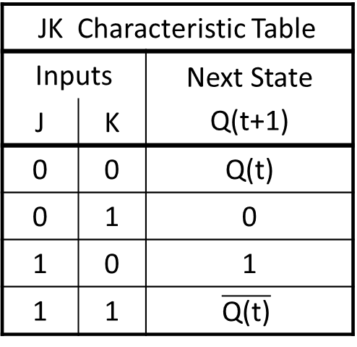
Example: Make D From JK
Add columns for the JK flip-flop inputs
Calculate these values for each row based on the current state and the desired next state
Refer to the characteristic table to see what input values make the required transition happen
Input | Curr State | Next State | FF Inputs
D | Q | N | J K
0 | 0 | 0
0 | 1 | 0
1 | 0 | 1
1 | 1 | 1
JK Characteristic Table
Inputs |  | Next State Q(t+1)
J | K
0 | 0 | Q(t)
0 | 1 | 0
1 | 0 | 1
1 | 1 | $$\overline{\text{Q}\text{(}\text{t}\text{)}}$$
01
or 00
01
or 11
10
or 11
10
or 00
Notes:
We add columns to the state table for the J and K inputs, and then determine the required J and K values that will produce the required state transition in each row. In the first row, the current state is 0 and the next state is 0, so we could use the reset behavior of the JK flip-flop or use its hold behavior.
In the second row, the current state is 1 and the next state is 0, so we could use the reset behavior of the JK flip-flop or use its toggle behavior. In the third row, we need the state machine to transition from state 0 to state 1, which we can do using the set behavior or the toggle behavior.
In the last row, we need the state machine to transition from state 1 back to state 1, so we could use the set behavior or the hold behavior. As you can see, for each row we have a choice of J and K values to cause the required state change. Before we can design our circuit, we will have to choose exactly which option to use.

Slide 11
Example: Make D From JK
Add columns for the JK flip-flop inputs
Calculate these values for each row based on the current state and the desired next state
Refer to the characteristic table to see what input values make the required transition happen
Input | Curr State | Next State | FF Inputs
D | Q | N | J K
0 | 0 | 0
0 | 1 | 0
1 | 0 | 1
1 | 1 | 1
Take advantage of the multiple options by using don’t-cares!
01
or 00
JK = 0X
01
or 11
JK = X1
10
or 11
JK = 1X
10
or 00
JK = X0
Notes:
If we look closely, we can see that some of our choices are related. For example, in the top row, as long as J is 0, either value of K will work. In other words, we “don’t care” what K is, as long as J is 0. We can go through and identify other don’t-cares, and then use them to help us optimize our circuit design. For this example, all of the rows can take advantage of a don’t-care condition. However, if there were a situation where the options could not be combined with a don’t-care, we would just have to pick one of the options.

Slide 12
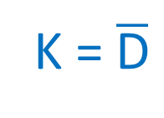
Example: Make D From JK
Create the required logic based on the state table
J = D
D = 0 → J = 0, K = 1 (reset)
D = 1 → J = 1, K = 0 (set)
K = $\overline{\text{D}}$
Notes:
Once the state table is complete, we implement the required logic for J and K. The J input logic reduces to D, and the K input logic reduces to /D. We can then implement the required logic, and we have created the behavior of a D flip-flop using a J-K flip-flop.

Slide 13
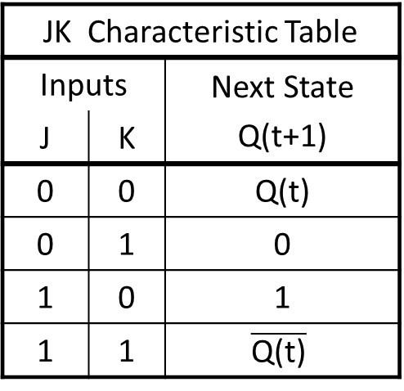
Example: Make JK From D
Express JK behavior using a state diagram
Create a state table
Input J K | Curr State Q | Next State D
0 0 (hold) | 0 1 | 0 1
0 1 (reset) | 0 1 | 0 0
1 0 (set) | 0 1 | 1 1
1 1 (toggle) | 0 1 | 1 0
JK Characteristic Table
Inputs |  | Next State Q(t+1)
J | K
0 | 0 | Q(t)
0 | 1 | 0
1 | 0 | 1
1 | 1 | $$\overline{\text{Q}\text{(}\text{t}\text{)}}$$
Notes:
For a second example, we can use a D flip-flop to implement JK behavior. We begin by creating a state diagram for the JK flip-flop, Then we create a state table based on the state diagram. Since we are implementing with D flip-flops, we don’t need a separate column for the D input of the flip-flop, since we know that would simply be a copy of the next-state column. Note that each pair of rows in the state table correspond to one of the behaviors of the JK flip-flop.

Slide 14
Example: Make JK From D
Create the required logic based on the state table
D = J$\overline{\text{Q}}$ + $\overline{\text{K}}$Q
Using $\overline{\text{Q}}$ output
Notes:
Once we have the state table, we find the minimized equation for the input of the D flip-flop, in terms of the circuit inputs J and K, and in terms of the flip-flop’s current state Q. We can then implement the circuit. Note that we used a flip-flop that had a /Q output – if we didn’t have that output, we would use an inverter to get /Q.

Slide 15
ECE 352 Digital System Fundamentals
Other Flip-Flop Types
Notes:
This concludes our video on other flip-flop types and their use in FSM design.

